Slide 1
Product Listing Responsive Pages

Slide 2
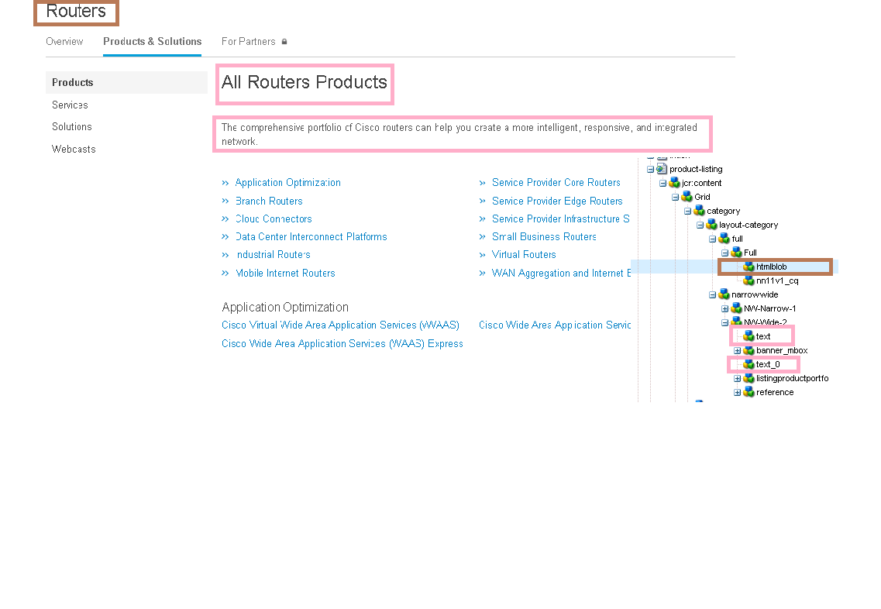
http://www.cisco.com/c/en/us/products/routers/product-listing.html
http://www.cisco.com/c/en/us/products/switches/product-listing.html
http://www.cisco.com/c/en/us/products/wireless/product-listing.html

